Slide 1
‘Expect the Unexpected’ Obstacles of the Single Narrative Story

Slide 2
Introductions
Professor JoAnne C. Maffia
-brief background
Say your name and year
Split into groups *branch out beyond friends

Slide 3
Discussion Norms
What are the expectations for the group?
Actively engage and listen. Devices off and away.
Speak your truth using ‘I’ statements like: “I feel”, “My experience has been”, “I thought”, etc.
Comfort with discomfort as we collaborate today.
This is just a beginning as we are learning, and we will be respectfully challenging ourselves and others.
Use respectful and mindful language.
We might not have all the answers today but we can reach out for more clarification and support.
This is a safe space.

Slide 4
Identity
Race: the significance and meaning that individuals place on race as a self-defining characteristic.
Ethnicity: a personal, self-categorizing concept in which an individual identifies with an ethnic group and its cultural identity can include National Identity.
Religion/Spirituality: is an institutionalized or personal system of beliefs and practices relating to the divine.
Gender: She/Her, He/Him, They/Them, Other
is each person’s internal and individual experience of gender. It is a person’s sense of being a woman, a man, both, neither, or anywhere along the gender spectrum. A person’s gender identity may be the same as or different from their sex assigned at birth.
Sexual Identity: is your sense of self in relation to your sexuality. As such, it encompasses many components, including gender identity and sexual orientation.
Sexual Orientation: sexual orientation is your sense of sexual or romantic attraction toward others.
Social Class Identity: social standing based income and/or one’s position in society (working poor, working class, middle class and upper class).
Ability Identity: A knowledge of self based on characteristics related to the body.
Neurodiversity: a concept that describes individuality and uniqueness in cognitive functioning.
Activity:
Individual Reflection: How do you identify? *Intersectionality = discuss brief
*Provide hand out (next slide)

Slide 5
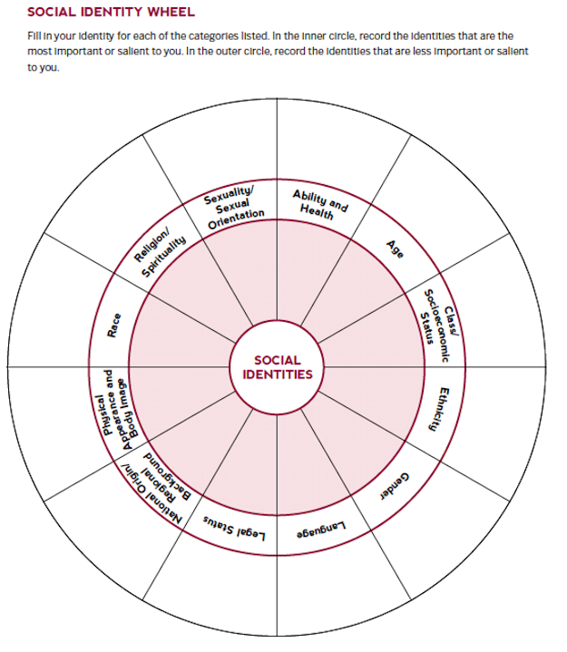
*Hand out to participants

Slide 6
What is a single narrative story?
ACTIVITY:
A. WATCH TOGETHER: approx. 20minutes https://www.ted.com/talks/chimamanda_adichie_the_danger_of_a_single_story)
B. Reflection
1. Individual Reflection
2. Share feedback with your group
3. Share feedback with all groups

Slide 7
SINGLE NARRATIVE STORY
It is a limited viewpoint that can lead to or create critical misunderstandings.
“The single story is where the same story gets told over and over again about a people or a place we do not know first-hand. The danger is that it leads to stereotypes, to half-truths and not the full truth.”
(Reference: https://abagond.wordpress.com/2009/10/30/the-single-story/)
Creating a singular, blanket narrative for an entire culture of people, for an entire geographic region, globally or locally, for an entire community, an entire race, an ethnicity, a religion, a gender, a sexual orientation or a disability and on and on and on… is never acceptable. And should be avoided, especially if you are to become an educator on the K-12 level.

Slide 8
Where to begin?
Single narrative story
EGO
YOU
Good intentions
Savior Complex

Slide 9
‘Knowing yourself’
In order to understand and respect your students for who they are and not who you think they are, you need to know yourself first. You may perceive yourself to be a certain way, think a certain way but you can never really know until you are out of your comfort zone. You must confront your conscious and unconscious biases.
What are conscious biases?
Biased attitudes towards a certain group you are aware of
What are unconscious biases?
Attitudes that are held subconsciously and affect the way individuals feel and think about others around them.

Slide 10
ACTIVITY:
A. What are your feelings for, attitudes about and experiences with other races, ethnicities, religions, sexual orientations, socio-economic classes, etc.? Do you have conscious biases? Do you have unconscious biases?
1. Individual Reflection
2. Discuss & share with your group

Slide 11
10 Minute Break

Slide 12
B. Have you created single narrative stories for people that are not like you? If so, what influences your stories: your family, the media, etc.?
1. Reflect
2. Use Bronfenbrenner’s Ecological Systems chart *next slide
3. Share & Discuss with your group
4. Share with all groups
Ex. All Asians are good at math. All Italians are gangsters, etc.

Slide 13
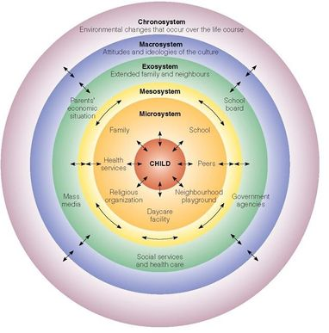
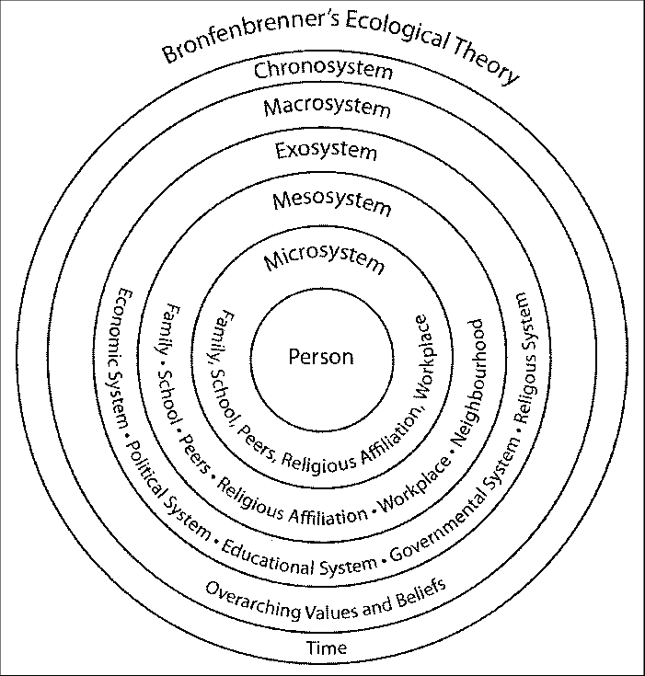
Bronfenbrenner’s chart is a great resource for understanding environmental influences that create and influence biases and attitudes about the ‘other’.

Slide 14
THE HIDDEN OBSTACLES APPEAR…
COMFORT ZONE
Being out of your comfort zone will certainly test the single narrative story you created for yourself.
“Andrea Lewis: There are many Black educators from middle and upper class communities who mostly want to teach in schools that are proximal to their own social and cultural position. They want to teach within their comfort zone. But my research demonstrates that when teachers open their eyes, minds, and hearts to teaching outside of their comfort zone, they learn, grow and become better teachers…. Despite my personal fears of teaching in a high poverty urban school during my first year of teaching, I learned that the first step to teaching in unfamiliar territory is to connect with students and show them you care. The rest falls into place, provided a teacher’s pedagogical foundation is solid.”
http://neatoday.org/2017/04/04/black-middle-class-teachers-face-unique-challenges-in-high-poverty-schools/
“MG: Like you I had a middle-class upbringing and I so wanted to help students learn. Unlike you though, I am Puerto Rican but I didn't grow up in the kind of neighborhoods my students grew up in. I can say that being Puerto Rican just like them didn't help me win the respect of my most disruptive students… I know that feeling well when I compared myself to other teachers who seemed to have control over their students. This reflection made me feel ten times worse than I already felt.” Reviewer on Goodreads.com
https://www.goodreads.com/book/show/22217707-the-battle-for-room-314

Slide 15
HIDDEN OBSTACLES APPEAR conscious and unconscious biases
Activity:
Have you ever been out of your comfort zone(s)? When? Where? Socially? In class? At work? At a restaurant? At a friend’s house? Taking a walk? Why?
Do single narrative stories factor into feeling comfortable or uncomfortable around others?
1. Reflection
2. Share Feed back with your group
3. Share with all groups
Ex. Having a girlfriend of color, working on my own unconscious biases and separating from my family’s beliefs, I still felt uncomfortable during Thanksgiving dinner, meeting her relatives for the first time. Despite having friends of color, I had never been alone with a black family.
Thoughts?

Slide 16
HIDDEN OBSTACLES continued
Good Intentions = Micro-Aggressions
Micro aggressions are the everyday verbal, nonverbal, and environmental slights, snubs, or insults, whether intentional or unintentional, which communicate hostile, derogatory, or negative messages to target persons based solely upon their marginalized group membership.
Activity:
1. Has anyone been on the receiving end of someone’s good intentions?
2. Share Feedback with all groups
Good intentions can, inadvertently, mask or expose a prejudice you weren’t conscious of having and in turn be offensive or insulting.
My work story:
A fellow teaching artist would criticize the free meal provided to our students during afterschool and Saturdays. She was a raw, vegan and would go on about the chemicals and preservatives. I took her aside and told her to stop criticizing the food in front of the students because they counted on those meals and sometimes that was their only meal of the day. She was unintentionally making the children feel bad about themselves; these kids were growing up in the shelter system. They would miss meals and their parents couldn’t afford expensive, organic fruits and vegetables.
Thoughts?

Slide 17
HIDDEN OBSTACLES continued
THE SAVIOR COMPLEX: EGO: I , Me, my wants, my needs, my expectations
“You say many white teachers come into the classroom believing that children of color need to be “saved.” What does that mean exactly, and why is this approach counterproductive?”
Chris Emdin: ”The vision that kids need to be saved equates to thinking something’s wrong with them. There’s no teacher who should go into a space thinking that the students are inherently bad. If you are walking into a classroom and see students as victims, you are seeing them as having an inherent flaw that only you can fix. You [the teacher] are there to help them learn and allow them to do fixing for themselves. The savior complex is also problematic because it reinforces the notion that the teacher is the hero. To be a good teacher the effective skill you need is not ego. It’s humility. You look at the natural, raw, unpolished beauty of the neighborhood, and if you are looking to save someone, you cannot see that…I’m not demonizing white folks or speaking to just white folks, I’m speaking to the rest of y’all too! There are black folks who also enforce those same white supremacist ideologies.”
What is white supremacist identity? *Great explanations
https://www.learningforjustice.org/magazine/fall-2018/what-is-white-privilege-really
https://www.whitesupremacyculture.info/characteristics.html
https://www.apa.org/news/podcasts/speaking-of-psychology/white-privilege
http://neatoday.org/2016/07/18/chris-emdin/
https://www.pbs.org/newshour/education/what-white-folks-who-teach-in-the-hood-get-wrong-about-education

Slide 18
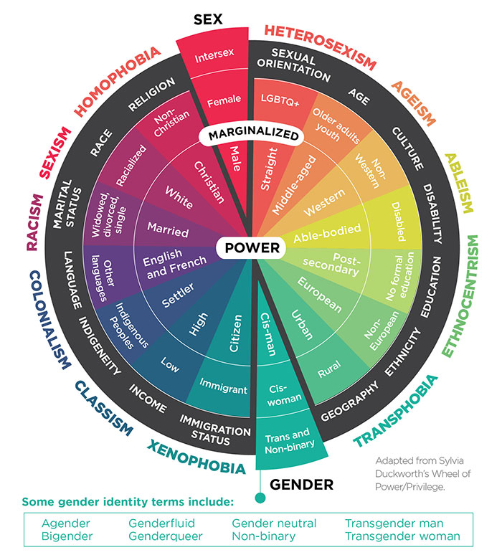
Power & Privilege

Slide 19
Where to begin?
Conscious bias
Unconscious bias
Single narrative stories
EGO
Me, my wants,
my needs, my perspective
Students
YOU
Good intentions
Micro aggressions,
unconscious bias
Savior Complex
Hero, ego,
Students are flawed

Slide 20
HIDDEN OBSTACLES continued
A great way to explore the inter-connectedness of having a savior complex mixed with good intentions and an ego is to look into this book as a critique: the author only ever saw his students as other and approached teaching as a struggle for power and control. His white fragility masked the deeper issues. Ed Borland only taught for one year
The Battle for Room 314: My year of hope and despair in a New York City High School
by Ed Boland
http://nypost.com/2016/01/17/my-year-of-terror-and-abuse-teaching-at-a-nyc-high-school/
“The book is certain to be controversial. There’s something dilettante-ish, if not cynical, about a well-off, middle-aged white man stepping ever so briefly into this maelstrom of poverty, abuse, homelessness and violence and emerging with a book deal.” (NY Post article by Maureen Callahan)
------
http://www.npr.org/sections/ed/2016/02/22/466300820/a-teacher-s-take-on-my-year-urban-teaching-memoirs
ACTIVITY:
1. READ: Review from NPRed by a veteran teacher, Nicole Dixon facilitated by Eric Westervelt:
2. Share feedback with all groups

Slide 21
Preconceived notions =
A failure to connect on a personal level
A failure to teach equitably
And a failure for true learning to take place.
*Everybody suffers in this scenario. When you truly understand your student body for who they are, you will have the ability to create a culture of positive learning. This becomes the foundation for creating realistic expectations and attainable goals as an educator.
Have Realistic Expectations
This doesn’t imply having ‘no expectations’ or ‘lowering your expectations’ it simply implies student-centered expectations
Create Attainable Goals
Your job and responsibility, is to experiment, create, teach and apply appropriate methods that aid your students in reaching student-centered goals. Small, structured goals, eventually, become the larger goal at hand.
Remember that expectations and goals are intertwined and connected; there is no room for your EGO.
Think ‘Teacher as Global Citizen’. Everyone is a citizen of the world and this presentation attempts to provide suggestions for improving humanity through the field of education. First start by improving yourself.

Slide 22
Single Narrative Story
Students
YOU
Single Narrative Story
YOURSELF
EGO
Good
intentions
Savior
Complex
Affects
Expectations
Affects
Goals
Student
Body

Slide 23
5 Minute Break

Slide 24
What types of information would be helpful to know before starting your teaching post?
1. Reflect on this question
2. Share questions and thoughts with all groups

Slide 25
Know Your Student Body
Relevant Information
Where are they living? Urban, suburban, rural, in a house, an apartment, a shelter?
What is their surrounding environment like?
Who makes up their community?
What is the history of their community?
What is the primary language or languages of their community?
What is the socio-economic status of their family, the community?
Is it economically diverse?
Is it ethnically diverse?
Is it racially diverse?
Are there any religious groups? And is there diversity among them?
What is the culture of the school including the administration?
What is the culture of the school regarding the LGBTQ community?
Is there a culture of bullying or tolerance?

Slide 26
‘It’s a Relationship’
Remember:
You are one person, you walk into a room of many and many usurps one.
Teaching is not a power play, be informed by your students.
You have to meet them where they are, not where you want them to be. This means you must take your ego out of it. Be open.
Leave your single narrative stories at the door including the one you created for yourself.
Children know when you care about them and when you don’t. The younger students may not be able to verbalize it but they do feel it and the older students will call you out on your BS so be real, be honest and be ready!
Be a student with your students.

Slide 27
Ending Reflection
What is one thing you have learned about yourself?
What is one thing you have learned from someone in your group?
What is one takeaway that you can immediately implement into your professional life as an educator?
How will you implement it, what would your ‘action plan’ be?
Optional: provide an example

Slide 28
Feedback Questionnaire
Has your understanding of the terminology grown?
What were the strengths of the presentation?
What questions still remain, if any?
Do you feel that you will be able to implement what you have learned into your daily life and educational practice?

Slide 29
The contents in this presentation are the creation and property of
JoAnne C. Maffia
Attribution-Noncommercial-NoDerivs CC BY-NC-ND
This license is the most restrictive of the Creative Common licenses, only allowing others to download your works and share them with others as long as they credit you, but they can’t change them in any way or use them commercially.
You must give proper credit to JoAnne C. Maffia if you share this presentation
You can not change this presentation in any way
You can not use this presentation for commercial or money-making purposes
https://creativecommons.org/
© 2022 JoAnne C. Maffia

